Slide 1

DADI INSTITUTE OF ENGINEERING & TECHNOLOGY
SLEEPING DISORDER PREDICTION
By
K. Harshitha (20U41A0543)
M. Manideepak (20U41A0542)
N. Mounika (20U41A0572)
K. Bhagya Sri (20U41A0574)
Under the Supervision of
Mrs. T. Santhoshi Lakshmi, ASSISTANT PROFESSOR,CSE
Dadi Institute of Engineering & Technology
DEPARTMENT OF ELECTRONICS & COMMUNICATION ENGINEERING
DADI INSTITUTE OF ENGINEERING & TECHNOLOGY
(AN AUTONOMOUS INSTITUTE)
ANAKAPALLE - 531002, VISAKHAPATNAM, A.P.
MARCH - 2024

Slide 2
ABSTRACT
Sleep disorders are a major public health problem, affecting millions of people worldwide. They can have a significant impact on an individual's health and well-being, leading to fatigue, decreased productivity, and increased risk of accidents and chronic diseases. The main objective of this data science project is to analyse various lifestyle and medical variables of individuals, such as age, BMI, physical activity, sleep duration, blood pressure, etc., and use this information to predict the occurrence and type of sleep disorder they may experience. Sleep disorders, like Insomnia and Sleep Apnea, can have significant impacts on an individual's health and overall well-being. The development of this predictive model has the potential to improve the early detection and treatment of sleep disorders. The potential impact of the project, such as the number of people who could be identified as being at risk of sleep disorders, or the cost savings that could be realized by early detection and treatment. By identifying individuals at risk of sleep disorders, appropriate interventions and treatments can be provided to improve their sleep quality and overall health.
D
I
E
T

Slide 3
INTRODUCTION
Sleeping disorders, encompassing a broad spectrum of conditions that disrupt normal sleep patterns, have become a pressing concern in contemporary healthcare. These disorders, which affect millions of individuals worldwide, can have profound implications for both physical and mental health. Timely and accurate diagnosis is essential for effective management and improving the quality of life for those afflicted. The advent of machine learning techniques has opened up new possibilities for predictive modeling in healthcare, and in particular, for the early identification of sleeping disorders. In this context, this project aims to harness the power of machine learning to predict sleeping disorders. By analyzing a diverse range of data, including sleep patterns, demographic information, and medical history, we seek to develop accurate and reliable predictive models. These models can serve as invaluable tools for healthcare professionals, assisting in the early diagnosis of various sleeping disorders, such as insomnia, sleep apnea, narcolepsy, and restless legs syndrome.
D
I
E
T

Slide 4
SLEEPING DISORDER TYPES:
INSOMNIA: Insomnia is a common sleep disorder that can make it hard to fall asleep or stay asleep.
SYMPTOMS:
Having a hard time falling asleep at night.
Waking up during the night.
Waking up too early.
Feeling tired or sleepy during the day.
Feeling cranky, depressed or anxious.
Having a hard time paying attention, focusing on tasks or remembering.
TREATMENT:
Cognitive behavioral therapy for insomnia can help you control or stop negative thoughts and actions that keep you awake. It's usually recommended as the first treatment for people with insomnia. Typically, CBT is as effective or more effective than sleep medicines.
D
I
E
T

Slide 5
2. SLEEP APNEA: Sleep apnea is a potentially serious sleep disorder in which breathing repeatedly stops and starts. If you snore loudly and feel tired even after a full night's sleep, you might have sleep apnea.
SYMPTOMS:
Loud snoring.
Episodes in which you stop breathing during sleep which would be reported by another person.
Gasping for air during sleep.
Awakening with a dry mouth.
Morning headache.
TREATMENT:
Continuous positive airway pressure (CPAP). If you have moderate to severe obstructive sleep apnea, you might benefit from using a machine that delivers air pressure through a mask while you sleep. With CPAP (SEE-pap), the air pressure is somewhat greater than that of the surrounding air and is just enough to keep your upper airway passages open, preventing apnea and snoring.
D
I
E
T

Slide 6
EXISTING SYSTEM:
1.Manual Sleep Tracking:
Prior methods relied on manually inputting sleep data into software, which could often lead to errors and inaccuracy.
2. Data Analysis:
Early methods in sleep disorder prediction used basic statistical methods to analyze data, which were often not sensitive to small variations in sleep patterns.
3. ML-Based Approaches:
The latest techniques use machine learning algorithms like convolutional neural networks to analyze complex sleep data and accurately predict sleep outcomes.
D
I
E
T

Slide 7
Advantages of existing system:
1. Early Detection: Machine learning algorithms enable the early detection of sleeping disorders by analyzing diverse sets of data, including sleep patterns and physiological indicators. This facilitates timely intervention and treatment.
2. Personalized Insights: Systems often provide personalized insights into individual sleep patterns, contributing to a more tailored approach in managing sleeping disorders. This personalization enhances the effectiveness of interventions and lifestyle recommendations.
3. Continuous Monitoring: Many systems allow for continuous monitoring of sleep-related metrics, providing a comprehensive view of an individual's sleep over time. This continuous data collection improves the accuracy of predictions and the understanding of sleep patterns.
D
I
E
T

Slide 8
Disadvantages of existing system:
1. Limited Generalization: Some machine learning models may struggle to generalize well across diverse populations. Training on specific datasets may result in models that are less effective when applied to individuals with different demographics or health conditions.
2. Data Privacy Concerns: The collection and analysis of sensitive health data raise concerns about privacy. Users may be hesitant to share detailed sleep-related information due to privacy and security issues, impacting the accuracy and inclusivity of the predictive models.
3. Accuracy Challenges: Achieving high accuracy in sleep disorder prediction can be challenging due to the complexity of sleep-related data and individual variations. False positives or negatives may occur, impacting the reliability of predictions.
D
I
E
T

Slide 9
PROPOSED STATEMENT:
Our proposed solution aims to revolutionize the identification and management of sleeping disorders by developing an advanced predictive model. This model will harness the power of digital gadgets and smart devices to collect comprehensive data on individuals' lifestyles and medical variables. To initiate this transformative process, researchers will embark on data collection, focusing on a wide array of parameters relevant to sleep health. Summary, our proposed solution leverages digital technology and predictive modeling to revolutionize the identification and management of sleeping disorders, offering a pathway to better sleep and enhanced quality of life for countless individuals.
D
I
E
T

Slide 10
Advantages of proposed statement:
1. Early Detection: Machine learning models can analyze patterns in sleep data, enabling early detection of potential sleeping disorders before they become severe.
2. Personalized Insights: Tailoring predictions based on individual sleep patterns allows for personalized insights, helping individuals understand their unique sleep needs and habits.
3. Improved Accuracy: ML algorithms can continuously learn and adapt, leading to improved accuracy in predicting sleeping disorders over time as more data becomes available.
4. Cost-Effective Screening: Machine learning-powered prediction models can provide a cost-effective and non-intrusive method for screening and identifying individuals at risk of sleeping disorders.
D
I
E
T

Slide 11
Disadvantages of proposed statement:
1. Data Privacy Concerns: Gathering and analyzing personal sleep data raises privacy concerns, requiring strict measures to protect individuals' sensitive information.
2. Bias in Data: If the training data used to develop the model is biased, it may lead to inaccuracies or discriminatory predictions, potentially exacerbating health disparities.
3. Reliance on Technology: Overreliance on machine learning predictions may discourage individuals from seeking professional medical advice, leading to delayed or inadequate healthcare intervention.
4. Limited Generalization: Models may struggle to generalize well across diverse populations or adapt to changes in lifestyle, limiting their effectiveness for broad application.
D
I
E
T

Slide 12
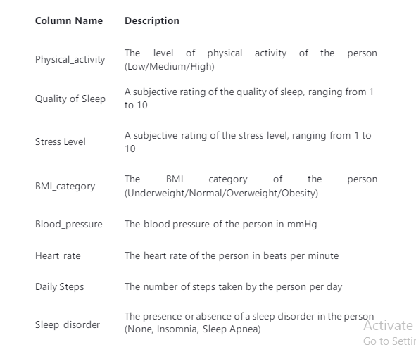
DATASET USED
The dataset used for this project is called the "Sleep Health and Lifestyle Dataset." It consists of 400 rows (individuals) and 13 columns (variables) that cover a wide range of information related to sleep patterns and daily habits. The dataset includes the following,

Slide 13
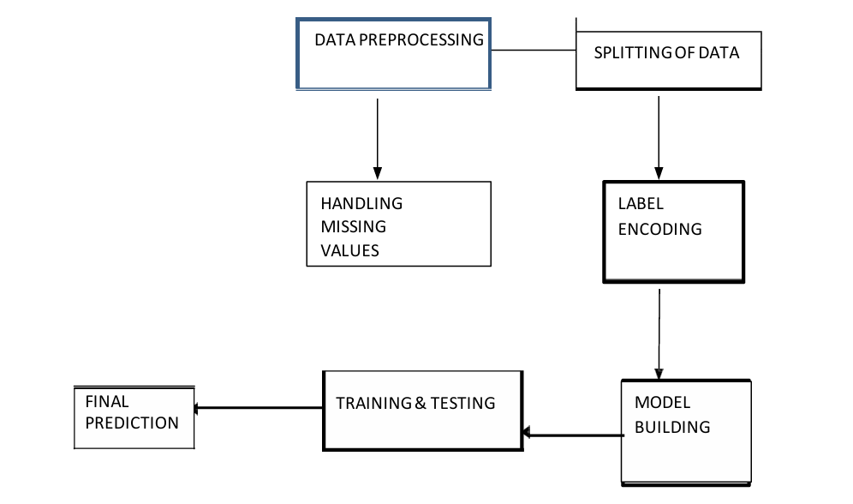
PROPOSED MODEL ARCHITECTURE
D
I
E
T

Slide 14
Hardware Requirements:
System version: Windows 7 or above
Processor: Intel i3 or above/ Ryzen
Hard Disk: 512GB HDD/SSD or above
RAM: 4GB or above
Software Requirements:
Technology/Language: Python
Operating System: Windows/Mac/Linux/Ubuntu
IDE: Jupyter, Google colab
Libraries: Numpy, Pandas, Matplotlib, Seaborn
D
I
E
T

Slide 15
METHODOLOGY USED
Several algorithms are utilized in the Sleeping disorder prediction. Some of the key methodologies include:
Decision Tree Classifier:
The Decision Tree Classifier is a simple yet powerful supervised learning algorithm that partitions the feature space into smaller regions based on feature values. At each node, it selects the best feature to split the data, optimizing a chosen criterion such as information gain or Gini impurity. This process continues recursively until a stopping criterion is met, such as a maximum tree depth or minimum number of samples per leaf. Decision trees are interpretable, making them useful for understanding feature importance and decision-making processes. However, they can be prone to overfitting, which can be mitigated with techniques like pruning or using ensemble methods. Overall, decision tree classifiers are versatile and widely used in various machine learning applications.
D
I
E
T

Slide 16
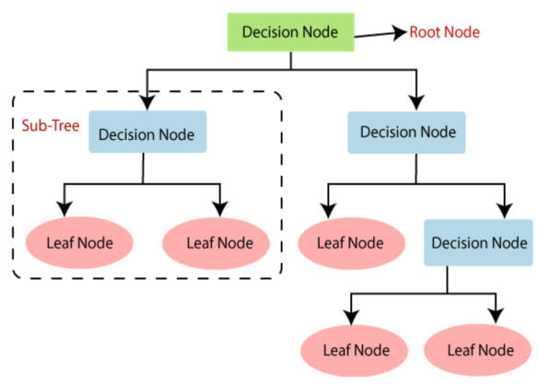
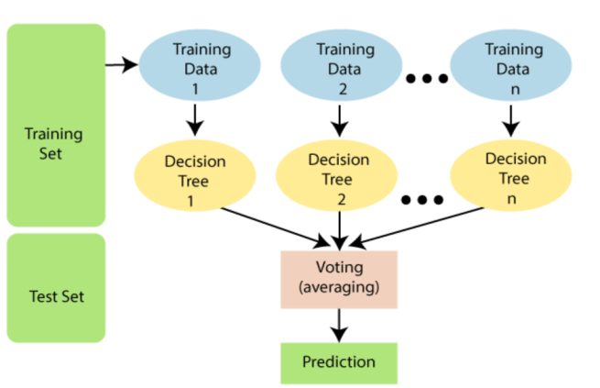
Random forest Classifier:
Random Forest is a popular ensemble learning technique that constructs multiple decision trees during training. Each tree is built on a bootstrapped sample of the training data and a random subset of features at each node. During prediction, the class with the most votes from all trees (classification) or the average prediction (regression) is chosen. Random Forests are robust against overfitting, handle high-dimensional data well, and are effective for both classification and regression tasks. They offer good generalization performance and are widely used in various domains due to their simplicity and effectiveness.
D
I
E
T

Slide 17
MODULES:
NUMPY: NumPy is a Python library used for working with arrays. It also has functions for working in domain of linear algebra, fourier transform, and matrices.
PANDAS: Pandas is a Python library used for working with data sets. It has functions for analyzing, cleaning, exploring, and manipulating data.
MATPLOTLAB: Matplotlib is a comprehensive library for creating static, animated, and interactive visualizations in Python. Matplotlib makes easy things easy and hard things possible.
SEABORN: Seaborn is a Python data visualization library based on matplotlib. It provides a high-level interface for drawing attractive and informative statistical graphics.
D
I
E
T

Slide 18
FUNCTIONAL REQUIREMENTS:
Functional requirements for a machine learning-based sleeping disorder prediction system may include:
1. Data Collection and Integration: Gather diverse and representative datasets containing sleep-related information. Integrate data from various sources, such as wearable devices, medical records, and lifestyle factors.
2. Feature Selection: Identify relevant features for sleep disorder prediction, including sleep duration, sleep patterns, activity levels, and potentially genetic or medical history.
3. Preprocessing and Cleaning: Implement data preprocessing techniques to handle missing values and outliers. Normalize or standardize features to ensure consistent input for the machine learning model.
D
I
E
T

Slide 19
NON-FUNCTIONAL REQUIREMENTS:
Non-functional requirements for a machine learning model predicting sleeping disorders may include:
1. Performance: Ensure the model can make predictions in a timely manner to support real-time or near-real-time applications.
2. Scalability: Design the model to handle an increasing volume of data as the user base grows.
3. Reliability: The model should consistently provide accurate predictions, minimizing false positives and false negatives.
4. Interpretability: Aim for a model that offers explanations for its predictions, aiding healthcare professionals in understanding and trusting the results.
D
I
E
T

Slide 20
CONCLUSION:
From the exploratory data analysis, I have concluded that the sleep orders depends upon three main factors that are gender, occupation and BMI of the patient. The males have more instance of Insomia whereas females have more instances of Sleep Apnea. In addition the that people with occupation such as nurses are more prone to sleep disorders. The BMI of the patient also plays a vital role in the prediction of sleep disorders. The patients who are either Obese or overweight are more prone to sleep disorders.
Coming to the classification models, both the models performed pretty good, however the Random Forest Classifier have excellent results with 87% accuracy.
D
I
E
T

Slide 21

D
I
E
T

